Slide 1
Group 9 - Data
By Karthik Rangaraj, Sucharita Mullapudi, Naga Santhosh Prathi, Mrudula Ravipati, Mounika Rayana, Akshay Popli, Sushma Keddallu Suriyaprakash and Chandrakanth Rajesh

Slide 2
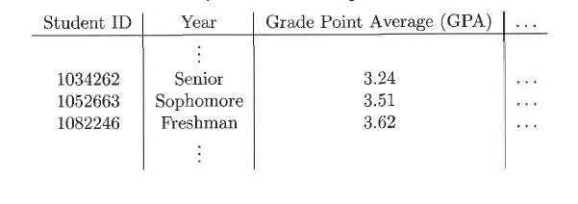
What is data?
Data is a collection of data objects and their attributes. An attribute is a characteristic of an object and a collection of attributes describe an object.
For example, the table below shows a data set that consists of student information. Each row corresponds to a student (data object) and each column is an attribute that describes some aspect of a student, such as grade point average (GPA) or identification number (ID).
Attribute values are numbers or symbols assigned to an attribute:
Same attribute can be mapped to different attribute values (e.g. height can be measured in feet or meters).
Different attributes can be mapped to the same set of values, but properties of attribute values can be different (e.g. ID and age are both integers, but ID has no max or min limit whereas age is between a fixed range).

Slide 3
Types of Attributes
The type of an attribute tells us what properties of the attribute are reflected in the values used to measure it.
The type of an attribute depends on which of the following properties it possesses:
Distinctness: = and ≠
Order: <, <=, > and >=
Addition: + and -
Multiplication: * and /
Different types of attributes:
Nominal(distinctness): nominal values provide only enough information to distinguish one object from another. (e.g. ID numbers, eye color, zip codes).
Ordinal(distinctness and order): The values of an ordinal attribute provide enough information to order objects. (e.g. rankings (e.g., taste of potato chips on a scale from 1-10), grades, height in {tall, medium, short}).
Interval(distinctness, order and addition): the differences between values are meaningful, i.e., a unit of measurement exists. (e.g. calendar dates, temperatures in Celsius or Fahrenheit).
Ratio(all 4 above properties) : Both differences and ratios are meaningful(e.g. temperature in Kelvin, length, time, counts).
An independent way of distinguishing between attributes is by the number of values they can take:
Discrete: A discrete attribute has a finite or countably infinite set of values. Such attributes can be categorical, such as zip codes or ID numbers, or numeric, such as counts. Discrete attributes are often represented using integer variables.
Continuous: A continuous attribute is one whose values are real numbers. Examples include attributes such as temperature, height, or weight. Continuous attributes are typically represented as floating-point variables.

Slide 4
Question
Considering data set of student information, what might be the other attributes that can be present in it other than what was previously seen before? Are any of these attributes a discrete attribute?

Slide 5
Types Of Data Sets
Data Sets are defined into three categories:
Record Data
Data Matrix
Document Data
Transaction Data
Graph-based Data
World Wide Web
Molecular Structures
Ordered Data
Spatial Data
Temporal Data
Sequential Data
Genetic Sequence Data

Slide 6
Data Preprocessing
Below are the different Data Preprocessing techniques
Aggregation
Sampling
Dimensionality Reduction
Feature subset selection
Feature creation
Discretization and Binarization
Attribute Transformation

Slide 7
Question
What is Transaction Data?
What is Sampling?

Slide 8

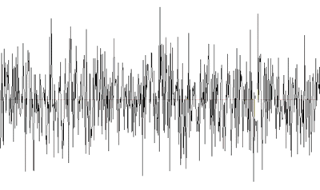
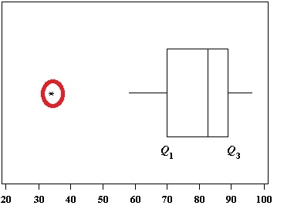
Noise and outliers
Noise refers to modification of original values.
Ex - Distortion of a person's voice when talking on an unstable network and distortion of images because of poor signal on a television.
Outliers can be defined as the data objects that have characteristics different from most of the other data objects.
Graphically we can define it as A value that "lies outside" (is much smaller or larger than) most of the other values in a set of data.

Slide 9
Missing values
Missing values occur mainly because of incorrect collection of the information.
Ex: People decline to give their age and weight.
Another reason for missing values could be attributes not applicable to all cases.
Ex: Monthly income is not applicable for children.
Handling missing values:
Elimination of Data objects and missing values and replacing with all possible values.
Ignore the missing value during the analysis.

Slide 10
question
Should outliers be considered or not during the analysis?

Slide 11
Similarity & Dissimilarity
Similarity:
It measures the degree to which two data objects are identical/alike .
This results in a numeric value mostly in the range of 0 to 1.
Similarity value is higher for identical objects.
Dissimilarity:
It measures the degree to which two data objects are different.
It also results in a numeric value but with a range from 0 to infinity.
Lower values of dissimilarity measure indicates when the data objects are alike
Proximity measures refers to the measures of similarity and dissimilarity.

Slide 12
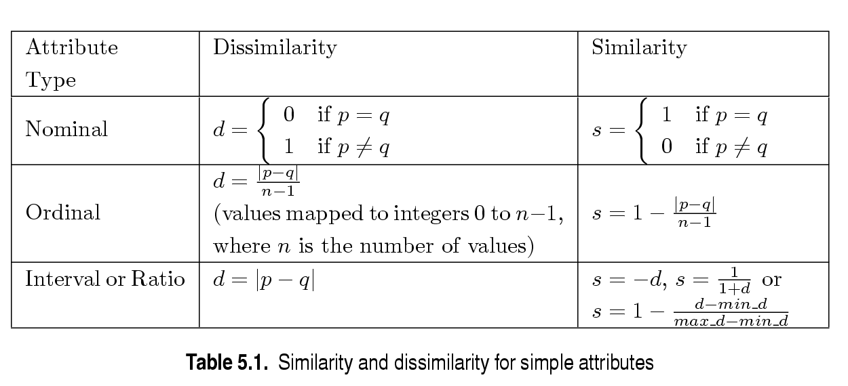
Similarity/Dissimilarity for Simple Attributes
Let p , q are attribute values of two data objects.
Introduction to data mining – Tan, Steinbach, Kumar

Slide 13
Question:
If two data objects are alike, what would be the similarity and dissimilarity values of that objects?

Slide 14
Common Properties of a Distance
Distances, such as the Euclidean distance, have some well-known properties.
d(p, q) ≥ 0 for all p and q and d(p, q) = 0 only if p = q. (Positive definiteness)
d(p, q) = d(q, p) for all p and q. (Symmetry)
d(p, r) ≤ d(p, q) + d(q, r) for all points p, q, and r. (Triangle Inequality)
where d(p, q) is the distance (dissimilarity) between points (data objects), p and q.
A distance that satisfies these properties is a metric.

Slide 15
Common Properties of a Similarity
Similarities, also have some well-known properties.
s(p, q) = 1 (or maximum similarity) only if p = q.
s(p, q) = s(q, p) for all p and q. (Symmetry)
where s(p, q) is the similarity between points (data objects), p and q.

Slide 16
Question:
What is the difference between similarity and distance measures?

Slide 17
Cosine similarity
Cosine Similarity is a measure of similarity between two non zero vectors of an inner product space. It is defined to equal the cosine of the angle between them, which is also same as the inner product of the same vectors normalized to both have length 1.
It is the judgment based on the orientation and not on magnitude. This means if two vectors have same orientation have a cosine of 1 and if they are 90 degree to each other, then cosine of similarity is 0.
Cosine similarity is most commonly used in high dimensional positive space.
Example where we can use Cosine Similarity is Text mining and information retrieval.

Slide 18
If d1 and d2 are two document vectors then: Cos(d1, d2) = (d1 * d2) / || d1|| || d2|| Advantages of Cosine Similarity are: 1. It has low complexity. 2. Only non zero values need to be considered. Other name of Cosine Similarity is Orchiai Similarity which is applied to binary data.

Slide 19
Question
What is the range of Cosine similarity?

Slide 20
Correlation
Correlation the process of establishing a relationship or connection between two or more measures.
Correlation is a statistic that measures the degree to which two variables move in relation to each other.
Compute correlation, we standardize data objects by taking their dot product.
Attributes are different, but similarity is needed.

Slide 21
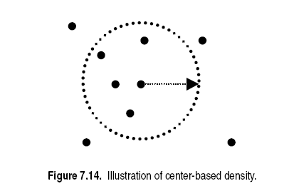
DENSITY
Density-based clustering require a notion of density
Euclidean Density is a simplest approach to divide region into number of rectangular cells of equal volume and define density.
Is the number of points within specified radius of point.
Euclidean Density

Slide 22
Question
To compute correlation, what rule do we use ?

Slide 23
FEATURE ENGINEERING
This process attempts to create additional relevant features from the existing raw features in the data, and to increase predictive power to the learning algorithm.
Methodologies:
Feature extraction - It is the process of creating new set of features from original raw data, highly domain specific
Mapping data to new space - Different view of data reveals important & interesting features
Feature construction - combination of features

Slide 24
FEATURE SELECTION
This process selects the key subset of original data features in an attempt to reduce the dimensionality of the training problem.
Redundant features: Duplicate much or all of the information contained in one or more other attributes.
Irrelevant features: contain no information that is useful for the data mining task.
Feature Selection Methods:
Brute-force approach: Trying all possible feature subsets.
Embedded approach: Feature selection occurs naturally as part of the data mining algorithm.
Filter approach: Features are selection is done before running the data mining algorithm

Slide 25
Question
Which Feature selection method gives high accuracy and low false positive rate?

